Slide 1
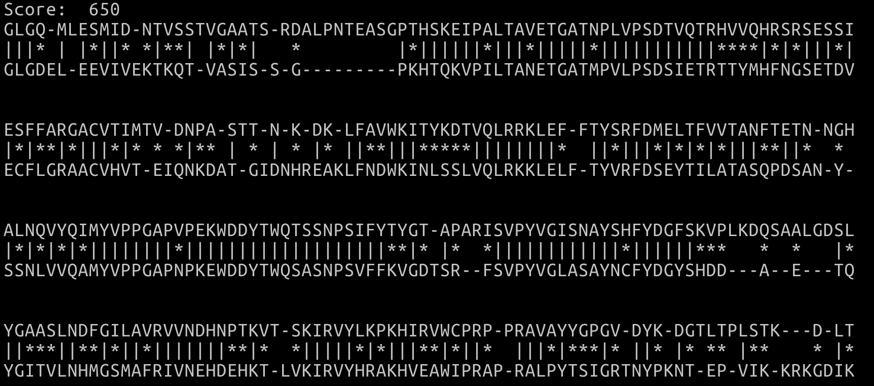
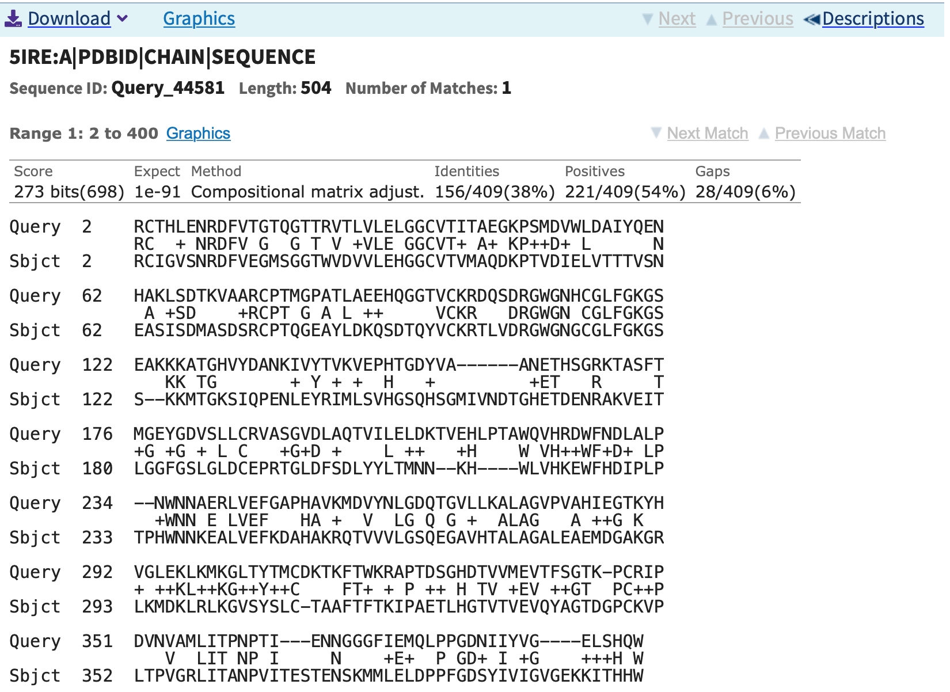
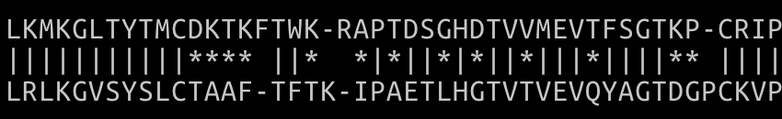
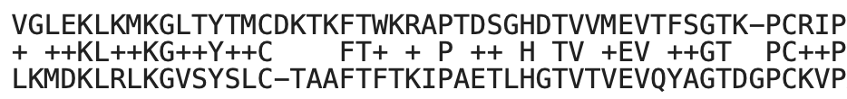
Project 1: Sequence Alignment using Dynamic Programming
Winston Van
Implementation
Load
Read BLOSUM matrix from file
Read both sequences from file or prompt
Construct
Make dict of tuples : scores
Make grid with length seq + 1
Needleman-Wunsch
Check Up, Left, Diagonal Neighbors
Write max to grid
Lookup scores in dict and add
Save copy of location of global max
Smith-Waterman
Copy Needleman-Wunsch algorithm
Write max or 0 if negative
Backtrack
Start from max
Choose largest of neighbors
Keep track of steps
Recurse until start
Output
Reverse backtracking steps
Print each move
Results
Conclusion
Polio-Rhino using SW (score: 650)
In the sequences examined, the dynamic programming algorithms proved to yield results similar to that of the alignment performed by Blast.
Generally, SW outperformed NW in alignment score.
Polio-Rhino using BLAST (score: 698)
Dengue-Zika Snippet using NW
Dengue-Zika Snippet using BLAST

